Slide 1
Gestão de equipas
13
13 - 1

Slide 2
Objetivos
Definir o que é um grupo e as fases do desenvolvimento dos grupos.
Descrever os principais componentes que influenciam o desempenho e a satisfação de um grupo.
Definir o que é uma equipa e as melhores práticas para influenciar o desempenho das equipas
Conhecer tópicos atuais sobre a gestão de equipas.
13 - 2

Slide 3
O que é um grupo?
Grupo – dois ou mais indivíduos que interagem, são interdependentes, e têm objetivos comuns.
  Grupos formais
    Grupos de trabalho, definidos pela organização, e aos quais foram atribuídas tarefas e objetivos.
  Grupos informais
    Grupos formados de maneira independente, para satisfazer as necessidades sociais dos seus membros.
13 - 3
Notes:
A group is defined as two or more interacting and interdependent individuals who come together to achieve specific goals. Formal groups are work groups defined by the organization’s structure and have designated work assignments and specific tasks directed at accomplishing organizational goals.
Informal groups are social groups. These groups occur naturally in the workplace and tend to form around friendships and common interests. For example, five employees from different departments who regularly eat lunch together are an informal group.

Slide 4
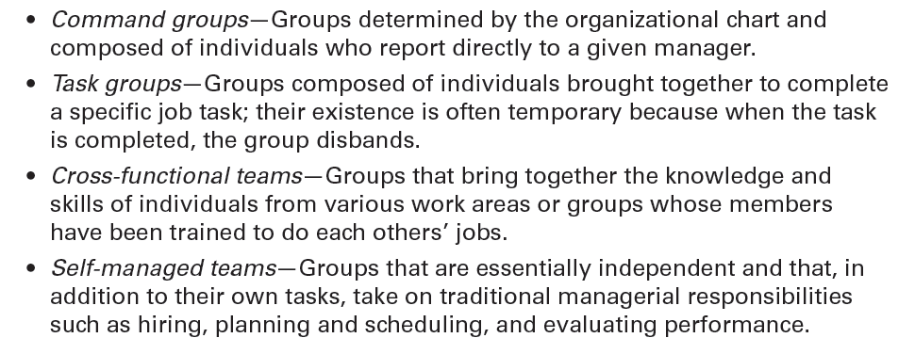
figura 13-1
Exemplos de grupos formais
13 - 4
Notes:
Exhibit 13-1 provides some examples of formal groups.

Slide 5
Fases do desenvolvimnto dos grupos
Formação (Forming) - Os membros juntam-se e definem a finalidade, a estrutura e a liderança.
Conflito inicial (Storming) – Existe conflito, entre os membros do grupo, no que respeita à liderança e ao modo de funcionamento do grupo. Durante esta fase ficará clara a hierarquia e alcança-se acordo em relação à finalidade e direção do grupo.
13 - 5
Notes:
Research shows that groups develop through five stages:
The forming stage has two phases. The first occurs as people join the group. In a formal group, people join because of some work assignment. Once they’ve joined, the second phase begins: defining the group’s purpose, structure, and leadership.
The storming stage is appropriately named because of the intragroup conflict. There’s conflict over who will control the group and what the group needs to be doing. During this stage, a relatively clear hierarchy of leadership and agreement on the group’s direction emerge.
The norming stage is one in which close relationships develop and the group becomes cohesive. There’s now a strong sense of group identity and camaraderie. This stage is complete when the group structure solidifies and the group has assimilated a common set of expectations (or norms) regarding member behavior.

Slide 6
Fases do desenvolvimnto dos grupos (cont.)
3. Regulação (Norming) - No grupo, desenvolvem-se boas relações e os membros conseguem ser coesos. Nesta fase ficam definidas as expectativas para os comportamentos no grupo.
Desempenho (Performing) - O grupo está completamente funcional.
13 - 6
Notes:
The fourth stage is the performing stage. The group structure is in place and accepted by group members. Their energies have moved from getting to know and understand each other to working on the group’s task. This is the last stage of development for permanent work groups.
For temporary groups—project teams, task forces, or similar groups that have a limited task to do—the final stage is adjourning. In this stage, the group prepares to disband. The group focuses its attention on wrapping up activities instead of task performance.

Slide 7
Fases do desenvolvimnto dos grupos (cont.)
5. Extinção (Adjourning) - Estádio final, característico dos grupos temporários. O grupo está mais preocupado com encerrar atividades do que com a realização de tarefas.
13 - 6
Notes:
The fourth stage is the performing stage. The group structure is in place and accepted by group members. Their energies have moved from getting to know and understand each other to working on the group’s task. This is the last stage of development for permanent work groups.
For temporary groups—project teams, task forces, or similar groups that have a limited task to do—the final stage is adjourning. In this stage, the group prepares to disband. The group focuses its attention on wrapping up activities instead of task performance.

Slide 8
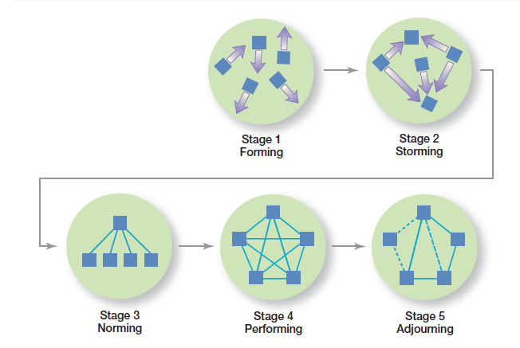
figura 13-2 fases do desenvolvimento dos grupos
13 - 7
Notes:
Exhibit 13-2 shows the stages of group development. The five stages are forming, storming, norming, performing, and adjourning.

Slide 9
Desempenho e satisfação dos grupos
Porque é que alguns grupos têm mais sucesso que outros?
  Capacidades dos membros do grupo;
  Tamanho do grupo;
  Nível de conflito;
  Pressões internas de conformidade.
13 - 8
Notes:
Why are some groups more successful than others? Why do some groups achieve high levels of performance and high levels of member satisfaction and others do not? The answers are complex, but include variables such as the abilities of the group’s members, the size of the group, the level of conflict, and the internal pressures on members to conform to the group’s norms.

Slide 10
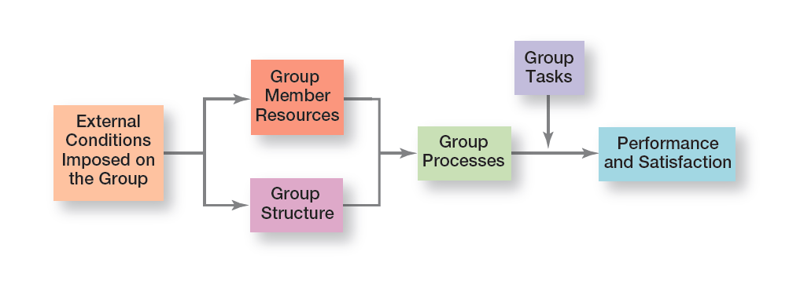
figura 13-3 modelo do desempenho e satisfação do grupo
13 - 9
Notes:
Exhibit 13-3 presents the major factors that determine group performance and satisfaction.

Slide 11
Condições externas
Os grupos de trabalho são afetados por condições externas, incluindo:
  Estratégia da organização;
  Relações de autoridade;
  Regras e procedimentos formais;
  Disponibilidade de recursos;
  Critérios de seleção dos empregados;
  Sistema de gestão do desempenho e cultura;
  Disposição física (layout) do local de trabalho do grupo.
13 - 10
Notes:
Work groups are affected by the external conditions imposed on it such as the organization’s strategy, authority relationships, formal rules and regulations, availability of resources, employee selection criteria, the performance management system and culture, and the general physical layout of the group’s work space.

Slide 12
Recursos dos membros do grupo
O potencial de desempenho de um grupo depende em larga medida dos recursos que cada indivíduo traz para o grupo, incluindo:
  Conhecimentos;
  Habilidades;
  Competências;
  Traços de Personalidade.
13 - 11
Notes:
A group’s performance potential depends to a large extent on the resources each individual brings to the group. These resources include knowledge, abilities, skills, and personality traits, and they determine what members can do and how effectively they will perform in a group. Interpersonal skills—especially conflict management and resolution, collaborative problem solving, and communication—consistently emerge as important for high performance by work groups.

Slide 13
Estrutura do grupo
Papeis – padrões de comportamento esperados de alguém que ocupa uma dada posição, numa unidade social.
Normas - regras ou expectativas aceites e partilhadas pelos membros de um grupo.
Groupthink (pensamento grupal) – resultado da pressão que o grupo exerce sobre os membros, para alinharem a sua opinião com a dos outros.
13 - 12
Notes:
A role refers to behavior patterns expected of someone occupying a given position in a social unit. In a group, individuals are expected to do certain things because of their position (role) in the group. These roles are generally oriented toward either getting work done or keeping group members happy.
All groups have norms—standards or expectations that are accepted and shared by a group’s members. Norms dictate things such as work output levels, absenteeism, promptness, and the amount of socializing on the job.
Because individuals want to be accepted by groups to which they belong, they’re susceptible to pressures to conform. But conformity can go too far, especially when an individual’s opinion differs significantly from that of others in the group. In such a case, the group often exerts intense pressure on the individual to align his or her opinion to conform to others’ opinions, a phenomenon known as groupthink. Groupthink seems to occur when group members hold a positive group image they want to protect and when the group perceives a collective threat to this positive image.

Slide 14
Estrutura do grupo (cont.)
Status – posição de prestígio dentro do grupo.
Social loafing (preguiça social) – tendência que os indivíduos têm para se esforçarem menos, quando trabalham em grupo, do que quando trabalham individualmente.
Coesão do grupo – grau em que os membros do grupo gostam de pertencer ao grupo e partilham os objetivos do grupo.
13 - 13
Notes:
Status systems are an important factor in understanding groups. Status is a prestige grading, position, or rank within a group. As far back as researchers have been able to trace groups, they have found status hierarchies. Status can be a significant motivator with behavioral consequences especially when individuals see a disparity between what they perceive their status to be and what others perceive it to be.
One important research finding related to group size concerns social loafing, which is the tendency for an individual to expend less effort when working collectively than when working individually. Social loafing may occur because people believe others in the group aren’t doing their fair share. Thus, they reduce their work efforts in an attempt to make the workload more equivalent.
Cohesiveness is important because it has been found to be related to a group’s productivity. Groups in which there’s a lot of internal disagreement and lack of cooperation are less effective in completing their tasks than groups in which members generally agree, cooperate, and like each other.

Slide 15

figura 13-4
Exemplos dos cartões de Asch
13 - 14
Notes:
Solomon Asch demonstrated the impact that conformity has on an individual’s judgment and attitudes. In these experiments, groups of seven or eight people were asked to compare two cards held up by the experimenter. One card had three lines of different lengths and the other had one line which was equal in length to one of the three lines on the other card (see Exhibit 13-4).

Slide 16
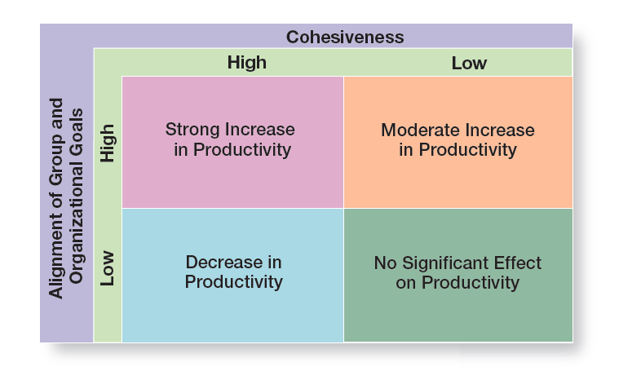
figura 13-5 coesão do grupo e produtividade
13 - 15
Notes:
Research has generally shown that highly cohesive groups are more effective than are less cohesive ones. However, the relationship between cohesiveness and effectiveness is complex. A key moderating variable is the degree to which the group’s attitude aligns with its goals or with the goals of the organization. (See Exhibit 13-5.)

Slide 17
Estrutura do grupo (cont.)
Tamanho do grupo
  Os grupos mais pequenos são mais rápidos na realização de tarefas simples.
  Os grupos grandes conseguem melhores resultados na resolução de problemas e nos benefícios decorrentes da diversidade.
  O fundador da Amazon, Jeff Bezos, utiliza a filosofia das “duas pizzas”, isto é, o número de pessoas máximo é o que pode ser alimentado com duas pizzas.
13 - 16
Notes:
What’s an appropriate size for a group? At Amazon, work teams have considerable autonomy to innovate and to investigate their ideas. Jeff Bezos, founder and CEO, uses a “two-pizza” philosophy; that is, a team should be small enough that it can be fed with two pizzas. This “two-pizza” philosophy usually limits groups to five to seven people depending, of course, on team member appetites.
Small groups are faster than larger ones at completing tasks. However, for groups engaged in problem solving, large groups consistently get better results than smaller ones. What do these findings mean in terms of specific numbers? Large groups—those with a dozen or more members—are good for getting diverse input. Thus, if the goal of the group is to find facts, a larger group should be more effective. On the other hand, smaller groups—from five to seven members—are better at doing something productive with those facts.

Slide 18
Estrutura do grupo (cont.)
Processos do grupo - processos que ocorrem num grupo de trabalho, incluindo:
  Comunicação;
  Tomada de decisão;
  Gestão de conflitos.
13 - 17
Notes:
The next factor that determines group performance and satisfaction concerns the processes that go on within a work group such as communication, decision-making, conflict management, and the like. These processes are important to understanding work groups because they influence group performance and satisfaction positively or negatively.

Slide 19
Estrutura do grupo (cont.)
Tomada de decisão em grupo – a maior parte das organizações tomam as decisões em grupo
Vantagens da tomada de decisão em grupo:
  Mais informação e maior conhecimento;
  Diversidade de experiência e de perspectivas;
  Maior aceitação da solução.
13 - 18
Notes:
Studies show that managers may spend up to 30 hours a week in group meetings. Undoubtedly, a large portion of that time is spent formulating problems, developing solutions, and determining how to implement the solutions. It’s possible, in fact, for groups to be assigned any of the eight steps in the decision-making process.
What advantages do group decisions have over individual decisions? One is that groups generate more complete information and knowledge. They bring a diversity of experience and perspectives to the decision process that an individual cannot. In addition, groups generate more diverse alternatives because they have a greater amount and diversity of information. Next, groups increase acceptance of a solution. Group members are reluctant to fight or undermine a decision they helped develop. Finally, groups increase legitimacy. Decisions made by groups may be perceived as more legitimate than decisions made by one person.
Group decisions also have disadvantages. One is that groups almost always take more time to reach a solution than it would take an individual. Another is that a dominant and vocal minority can heavily influence the final decision. In addition, groupthink can undermine critical thinking in the group and harm the quality of the final decision. Finally, in a group, members share responsibility, but the responsibility of any single member is ambiguous.

Slide 20
Estrutura do grupo (cont.)
Tomada de decisão em grupo – a maior parte das organizações tomam as decisões em grupo (cont.)
Desvantagens da tomada de decisão em grupo:
  Mais demorada;
  Pessoas (ou minorias) dominadoras, podem influenciar a decisão;
  Groupthink (pensamento grupal).
13 - 18
Notes:
Studies show that managers may spend up to 30 hours a week in group meetings. Undoubtedly, a large portion of that time is spent formulating problems, developing solutions, and determining how to implement the solutions. It’s possible, in fact, for groups to be assigned any of the eight steps in the decision-making process.
What advantages do group decisions have over individual decisions? One is that groups generate more complete information and knowledge. They bring a diversity of experience and perspectives to the decision process that an individual cannot. In addition, groups generate more diverse alternatives because they have a greater amount and diversity of information. Next, groups increase acceptance of a solution. Group members are reluctant to fight or undermine a decision they helped develop. Finally, groups increase legitimacy. Decisions made by groups may be perceived as more legitimate than decisions made by one person.
Group decisions also have disadvantages. One is that groups almost always take more time to reach a solution than it would take an individual. Another is that a dominant and vocal minority can heavily influence the final decision. In addition, groupthink can undermine critical thinking in the group and harm the quality of the final decision. Finally, in a group, members share responsibility, but the responsibility of any single member is ambiguous.

Slide 21
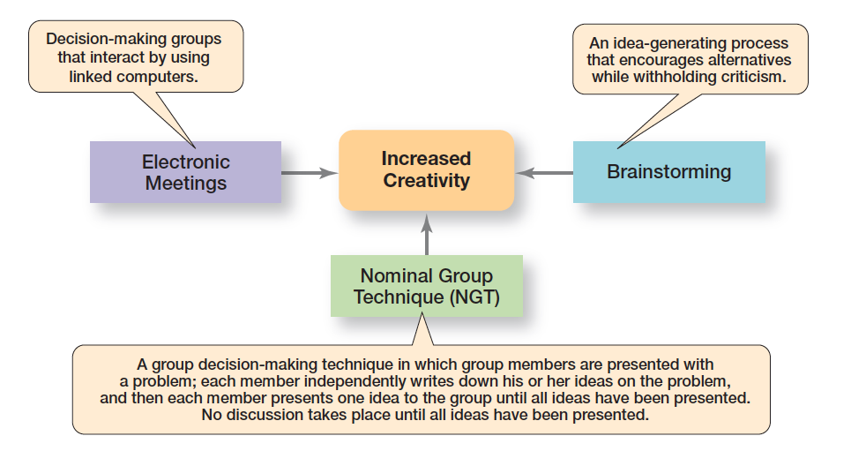
figura 13-6
Criatividade na tomada de decisão em grupo
13 - 19
Notes:
What techniques can managers use to help groups make more creative decisions? Exhibit 13-6 describes three possibilities.

Slide 22
Gestão do conflito
Conflito: perceção de diferenças incompatíveis que resulta em interferência ou oposição.
Visão tradicional – todo o conflito é mau e deve ser evitado.
Visão das relações humanas – o conflito é natural e inevitável num grupo.
Visão interacionista – é necessário existir algum conflito, para que o grupo tenha um bom desempenho.
13 - 20
Notes:
Conflict is perceived incompatible differences resulting in some form of interference or opposition. Whether the differences are real is irrelevant. If people in a group perceive that differences exist, then there is conflict.
The traditional view of conflict argues that conflict must be avoided—that it indicates a problem within the group. Another view, the human relations view of conflict, argues that conflict is a natural and inevitable outcome in any group and need not be negative but has the potential to be a positive force in contributing to a group’s performance.

Slide 23
Gestão do conflito (cont.)
Tipologias de conflito (1/2):
Conflito funcional – conflito que resulta num maior desempenho do grupo.
Conflito disfuncional – conflito que impede o grupo de atingir os seus objetivos.
13 - 21
Notes:
The third and most recent view, the interactionist view of conflict, proposes that not only can conflict be a positive force in a group but that some conflict is absolutely necessary for a group to perform effectively.
The interactionist view doesn’t suggest that all conflicts are good. Some conflicts—functional conflicts—are constructive and support the goals of the work group and improve its performance. Other conflicts—dysfunctional conflicts—are destructive and prevent a group from achieving its goals.

Slide 24
Gestão do conflito (cont.)
Tipologias de conflito (2/2):
Conflito de tarefa – conflito sobre o conteúdo e os objetivos do trabalho.
Conflito de relacionamento – conflito baseado em relações interpessoais.
Conflito de processo – conflito sobre como o trabalho deve ser feito.
13 - 22
Notes:
Task conflict relates to the content and goals of the work. Relationship conflict focuses on interpersonal relationships.
Process conflict refers to how the work gets done. Research shows that relationship conflicts are almost always dysfunctional because the interpersonal hostilities increase personality clashes and decrease mutual understanding and the tasks don’t get done. On the other hand, low levels of process conflict and low-to-moderate levels of task conflict are functional. For process conflict to be productive, it must be minimal.
Otherwise, intense arguments over who should do what may become dysfunctional and can lead to uncertainty about task assignments, increase the time to complete tasks, and result in members working at cross-purposes.

Slide 25
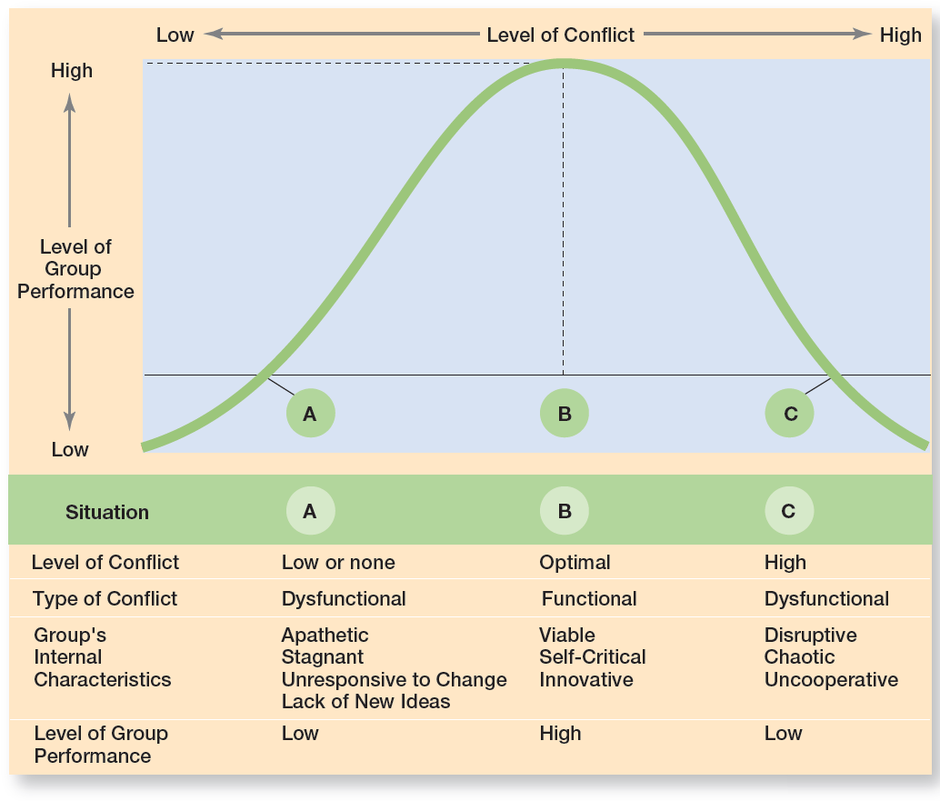
figura 13-7
Conflito e desempenho do grupo
13 - 23
Notes:
Exhibit 13-7 illustrates the challenge facing managers.

Slide 26
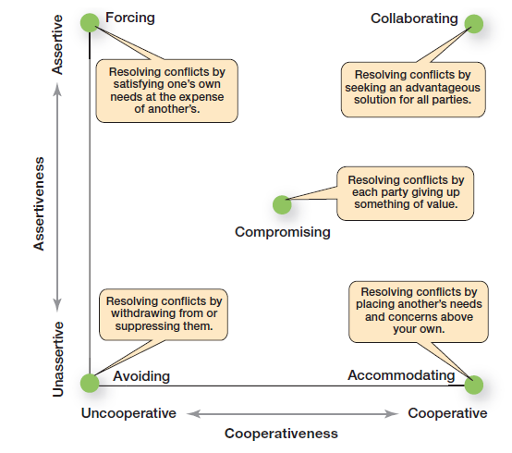
figura 13-8 técnicas de gestão do conflito
13 - 24
Notes:
When group conflict levels are too high, managers can select from five conflict management options: avoidance, accommodation, forcing, compromise, and collaboration. (See Exhibit 13-8 for a description of these techniques.)

Slide 27

Transformar grupos em equipas eficazes
Equipas de trabalho
Grupos cujos membros trabalham intensamente num objetivo específico e partilhado, utilizando a sua sinergia positiva, responsabilidade mútua e competências complementares.
13 - 25
Notes:
Most of you are probably familiar with teams, especially if you’ve watched or participated in organized sports events. Work teams differ from work groups and have their own unique traits. Work groups interact primarily to share information and to make decisions to help each member do his or her job more efficiently and effectively.
There’s no need or opportunity for work groups to engage in collective work that requires joint effort. On the other hand, work
teams are groups whose members work intensely on a specific, common goal using their positive synergy, individual and mutual
accountability, and complementary skills.

Slide 28
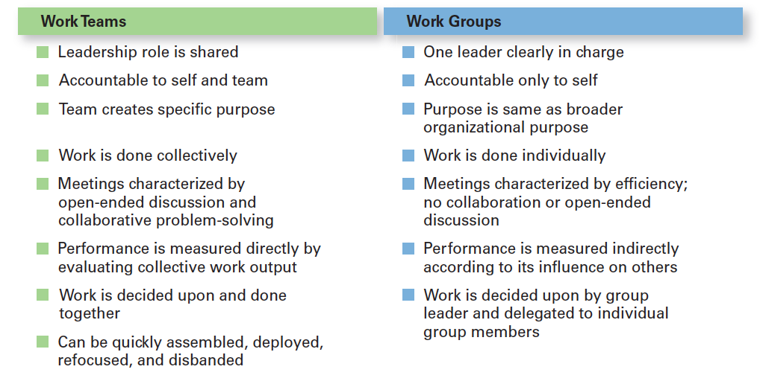
figura 13-9
Grupos e equipas
13 - 26
Notes:
Work teams differ from work groups and have their own unique traits (see Exhibit 13-9).

Slide 29
Tipos de equipas de trabalho
Equipa de resolução de problemas – equipa em que os membros são do mesmo departamento, ou área funcional, e que tem como objetivo melhorar as atividades de trabalho ou resolver problemas específicos.
Equipa em autogestão – equipa que funciona sem um gestor e que é responsável por um processo de trabalho ou por um segmento de um processo de trabalho.
13 - 27
Notes:
When work teams first became popular, most were problem-solving teams, teams from the same department or functional area involved in efforts to improve work activities or to solve specific problems. Members share ideas or offer suggestions on how work processes and methods can be improved. However, these teams are rarely given the authority to implement any of their suggested actions.
Although problem-solving teams were helpful, they didn’t go far enough in getting employees involved in work-related decisions and processes. This shortcoming led to another type of team, a self-managed work team, a formal group of employees who operate without a manager and are responsible for a complete work process or segment. A self-managed team is responsible for getting the work done and for managing themselves, which usually includes planning and scheduling of work, assigning tasks to members, collective control over the pace of work, making operating decisions, and taking action on problems.

Slide 30
Tipos de equipas de trabalho
(cont.)
Equipas multidisciplinares / multidepartamentais - equipa composta por indivíduos oriundos de várias áreas funcionais.
Equipas virtuais - equipa que utiliza a tecnologia para ligar membros que estão fisicamente distantes, de modo a que os objetivos possam ser cumpridos.
13 - 28
Notes:
The third type of team is the cross-functional team which is a work team composed of individuals from various functional specialties. Many organizations use cross-functional teams.
The final type of team is the virtual team, a team that uses technology to link physically dispersed members to achieve a common goal. In a virtual team, members collaborate online with tools such as wide-area networks, videoconferencing, fax, e-mail, or Web sites where the team can hold online conferences. Virtual teams can do all the things that other teams can—share information, make decisions, and complete tasks; however, they lack the normal give-and-take of face-to-face discussions.

Slide 31
Criar equipas de trabalho eficazes
Objetivos claros – todos os membros conhecem e compreendem os objetivos a ser atingidos.
Competências relevantes – os membros têm as competências técnicas e interpessoais necessárias.
Confiança mútua – existe uma elevada confiança entre os membros.
Compromisso – os membros estão empenhados em atingir os objetivos.
13 - 29
Notes:
However, research on teams provides insights into the characteristics typically associated with effective teams.
High-performance teams have a clear understanding of the goal to be achieved. Members are committed to the team’s goals, know what they’re expected to accomplish, and understand how they will work together to achieve these goals.
Effective teams are composed of competent individuals who have the necessary technical and interpersonal skills to achieve the desired goals while working well together. This last point is important because not everyone who is technically competent has the interpersonal skills to work well as a team member.
Effective teams are characterized by high mutual trust among members. That is, members believe in each other’s ability, character, and integrity. But as you probably know from personal relationships, trust is fragile. Maintaining this trust requires careful attention by managers.
Unified commitment is characterized by dedication to the team’s goals and a willingness to expend extraordinary amounts of energy to achieve them. Members of an effective team exhibit intense loyalty and dedication to the team and are willing to do whatever it takes to help their team succeed.

Slide 32
Criar equipas de trabalho eficazes
Boa comunicação – as mensagens são compreendidas com clareza.
Competências de negociação – os membros conseguem resolver diferentes posições.
Liderança apropriada – os líderes motivam a equipa quando em situações difíceis.
Apoio Interno e externo – formação, incentivos e recursos apropriados.
13 - 30
Notes:
Not surprisingly, effective teams are characterized by good communication. Members convey messages, verbally and nonverbally, between each other in ways that are readily and clearly understood. Also, feedback helps guide team members and correct misunderstandings.
Effective teams are continually making adjustments to whom does what. This flexibility requires team members to possess negotiating skills. Because problems and relationships regularly change within teams, members need to be able to confront and reconcile differences.
Effective leaders are important. They can motivate a team to follow them through the most difficult situations. How? By clarifying goals,
demonstrating that change is possible by overcoming inertia, increasing the self-confidence of team members, and helping members to more fully realize their potential. Increasingly, effective team leaders act as coaches and facilitators. They help guide and support the team, but don’t control it. Studies have shown that when a team leader’s emotional displays—positive and negative—are used at appropriate times, the team’s functioning and performance can be enhanced.

Slide 33
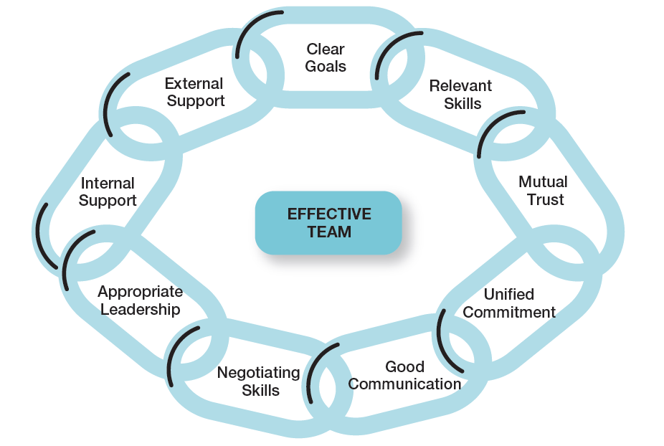
figura 13-10
Características das equipas eficazes
13 - 31
Notes:
However, research on teams provides insights into the characteristics typically associated with effective teams. These characteristics
are listed in Exhibit 13-10.

Slide 34
Desafios atuais na gestão de equipas
Recursos dos membros do grupo nas equipas globais – os gestores têm de compreender as características culturais dos membros do grupo.
Estrutura do grupo – tópicos relativos à conformidade, status, social loafing e coesão.
Processos do grupo – os grupos multiculturais conseguem tirar maior partido da diversidade de ideias.
13 - 32
Notes:
In global organizations, understanding the relationship between group performance and group member resources is more challenging because of the unique cultural characteristics represented by members of a global team. In addition to recognizing team members’ abilities, skills, knowledge, and personality, managers need to be familiar with and clearly understand the cultural characteristics of the groups and the group members they manage.
Some of the structural areas where we see differences in managing global teams include conformity, status, social loafing, and cohesiveness. Are conformity findings generalizable across cultures? Research suggests that Asch’s findings are culture-bound. For instance, as might be expected, conformity to social norms tends to be higher in collectivistic cultures than in individualistic cultures. Despite this tendency, however, groupthink tends to be less of a problem in global teams because members are less likely to feel pressured to conform to the ideas, conclusions, and decisions of the group.
The processes global teams use to do their work can be particularly challenging for managers. For one thing, communication issues often arise because not all team members may be fluent in the team’s working language. This can lead to inaccuracies, misunderstandings, and inefficiencies. However, research also has shown that a multicultural global team is better able to capitalize on the diversity of ideas represented if a wide range of information is used.

Slide 35
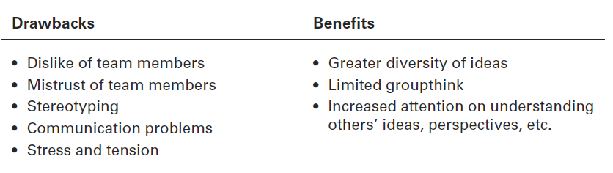
figura 13-11 equipas globais
13 - 33
Notes:
What do we know about managing global teams? We know there are both drawbacks and benefits in using global teams (see Exhibit 13-11).
Using our group model as a framework, we can see some of the issues associated with managing global teams.

Slide 36
Compreender as redes sociais
Redes sociais
  Padrões de ligações informais entre indivíduos que fazem parte de um grupo.
A importância das redes sociais
  Os relacionamentos podem potenciar ou diminuir a eficácia do grupo.
  Os relacionamentos aumentam a prossecução de objetivos e aumentam o compromisso dos membros para com a equipa.
13 - 34
Notes:
We can’t leave this chapter on managing teams without looking at the patterns of informal connections among individuals within groups—that is, at the social network structure. What actually happens within groups? How do group members relate to each other and how does work get done? Managers need to understand the social networks and social relationships of work groups. Why? Because a group’s informal social relationships can help or hinder its effectiveness.

Slide 37


